Slide 1
The UK’s First Urban 5G Test-Network
Dimitra Simeonidou, University of Bristol
January 2018

Slide 2
Demonstrations & Use Cases

Slide 3

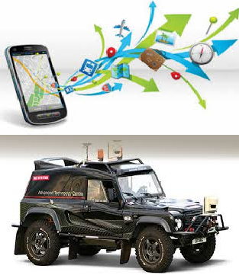
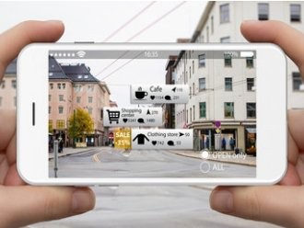
Smart Innovations
City Data Visualisation
Smart Tourism
Augmented Reality
Autonomous Transport

Slide 4
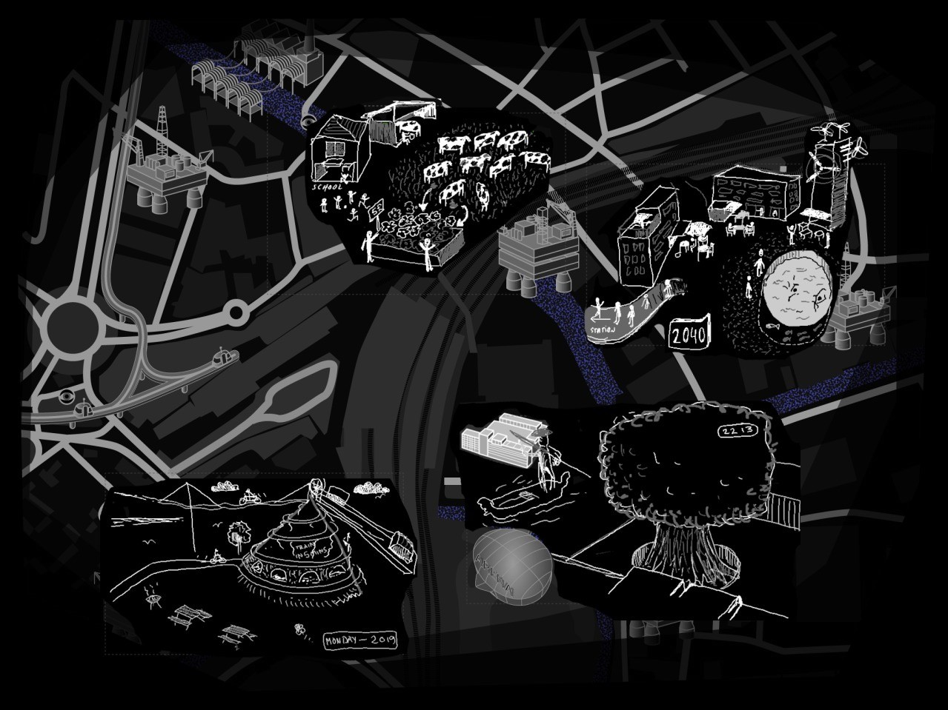
Demonstrators – Use Case 1
Billennium Square
A visitors’ experience application: to combine 5G network capability and creativity
A theatrical guided tour of the city in the future (utopian and dystopian)
Involves an actor telling stories, a group of participants (10-15) with AR terminals, and an artist illustrator
Collaboratively imagine future architectures, seeing it drawn real-time and in situ, using augmented reality and spatial sound
Devices connected via network requiring low latency and synchronised connectivity between the participants, the actor and the illustrator.
Layered Realities Network Capability Demonstrators

Slide 5
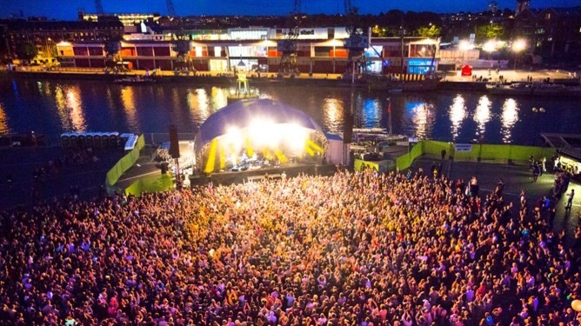
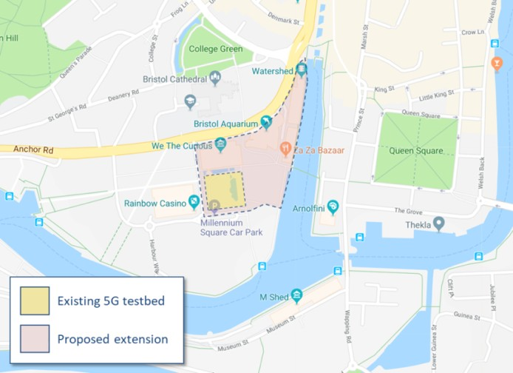
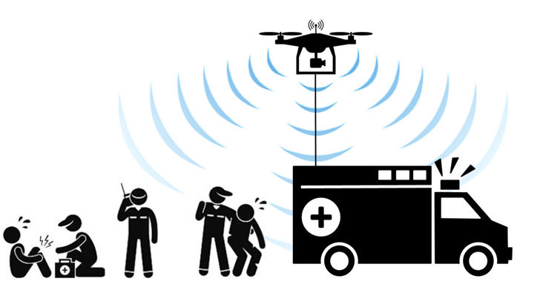
Use Case 4 : Public Safety utilising 5G
Demonstrate how public safety can be improved through 5G by enabling:
  Robust, mission-critical, interoperable public safety communications
  Effective and efficient use of the available spectrum (including sharing licensed and unlicensed spectrum)
  Advanced 5G communications technologies such as new radio and network slicing
The expected benefits to public safety from 5G include:
  For the user: Appear ubiquitous and limitless, Support emerging applications: Emergency sensor networks
  For Operator: Higher area capacity (1000x greater) • Higher capacity density • Higher connection density (~10,000/km2) • Lower latency (ms) • Lower energy consumption • Software-defined flexibility
It will involve the Harbour side area of the Bristol City Centre, an adjacent area to the Millennium Square where the existing Bristol 5G testbed is currently located.
The 5G technologies to be used in the Safety Use Case include:
  Millimetre wave backhauling, 5G small cells,
  High-density Wi-Fi network for off-load 5G traffic and crowd movement monitoring,
  Software Defined Networki Orchestration,
  Network slicing to deliver tailored network services to different user groups, devices or applications
    On-demand creation of Incident Area wireless network.

